Slide 1

Module 6
Arrays, Lists, and Iteration

Slide 2
Iteration: While Loops

Slide 3
Content (slot 3)
Iteration Control Structure Revisited
While Loops
Testing While Loops
Do-While Loops
Spawning Into a Collision-Free Location
Putting It All Together
Common Mistakes

Slide 4
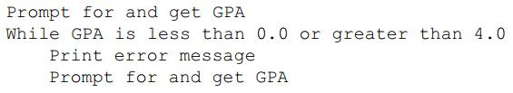
6.19 Iteration Control Structure Revisited
Example 6.1: Getting a Valid GPA
Problem Description
Write an algorithm that will ask for a GPA until a valid GPA is entered.
Algorithm

Slide 5
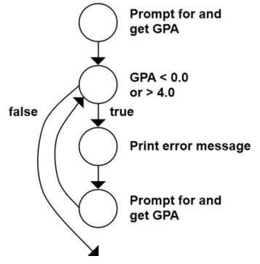
6.19 Iteration Control Structure Revisited
CFG for Example 6.1

Slide 6
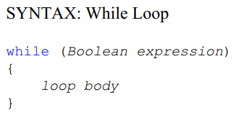
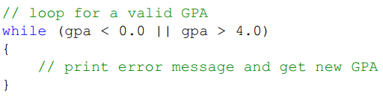
6.20 While Loops
Implement Example 6.1
add the while part of the loop

Slide 7
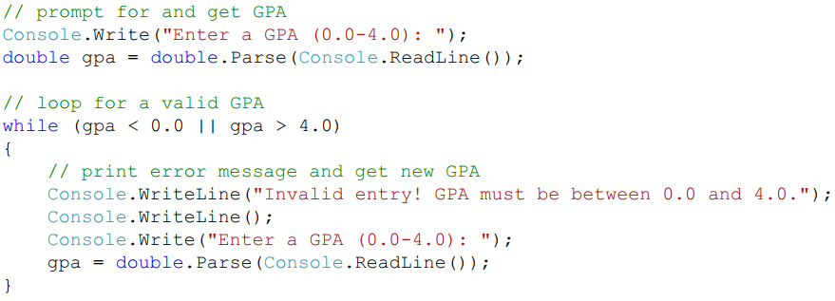
6.20 While Loops
Implement Example 6.1
implement the rest of the algorithm

Slide 8
6.20 While Loops
Implement Example 6.1
implement the rest of the algorithm

Slide 9
6.20 While Loops
ITM
Initialize the variables contained in the Boolean expression.
Tests the Boolean expression to see if the loop body should execute or not.
Modify at least one of the variables in the Boolean expression (give it a new value).
What happens if we forget about ITM?
Example 6.2: Printing Squares of the Integers from 1 to n
Problem Description:
Write a program that will print the squares of the integers from 1 to n, where n is provided by the user.

Slide 10
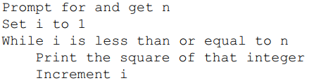
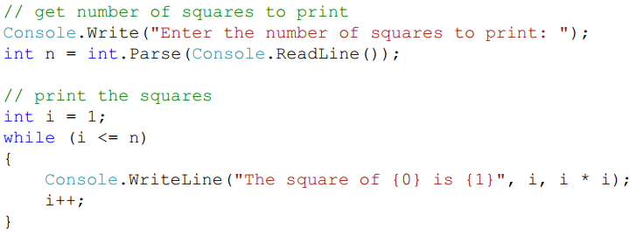
6.20 While Loops
Example 6.2: Printing Squares of the Integers from 1 to n
Algorithm:
Implementation

Slide 11
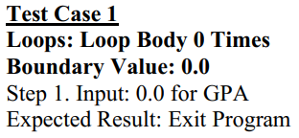
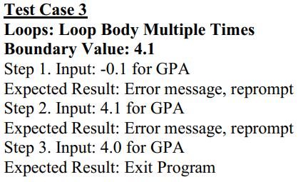
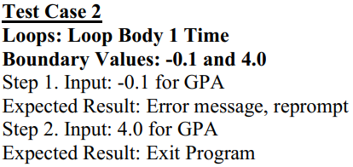
6.21 Testing While Loops

Slide 12
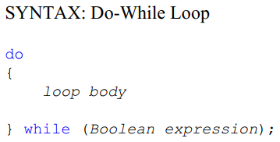
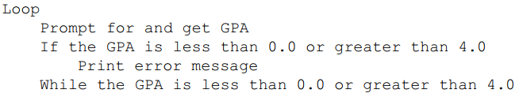
6.22 Do-While Loops
Algorithm of Example 6.1

Slide 13
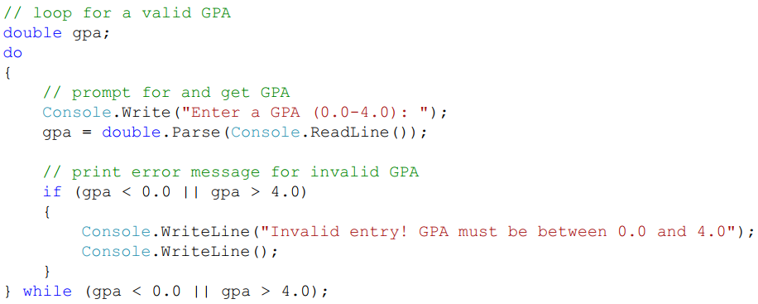
6.22 Do-While Loops
Implementation

Slide 14
6.23 Spawning Into a Collision-Free Location
In the Putting It All Together problem in Module 4, a teddy bear shouldn't be spawn on top of a teddy bear that's already in the game, but that we needed to know about while loops first. Now use while loops to solve this problem.
All work will be in the TeddyBearSpawner script because this problem needs to be handled when a new teddy bear is being spawn.
The big idea is that
We'll pick a random location for the teddy bear we're spawning, then check to see if the collider for the new teddy bear would collide with anything already in the game.
If it wouldn't, we spawn the teddy bear at that location and we're done. If it would collide with something, though, we randomly generate a new location and do the check again.
We keep doing this until we find a collision-free location for the new teddy bear or we decide to give up on this spawn attempt.

Slide 15
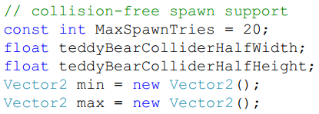
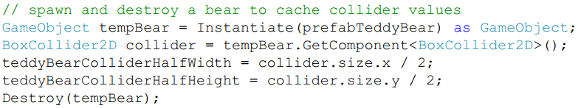
6.23 Spawning Into a Collision-Free Location
Add five more fields
Add code to the TeddyBearSpawner Start method to retrieve and save those dimensions

Slide 16
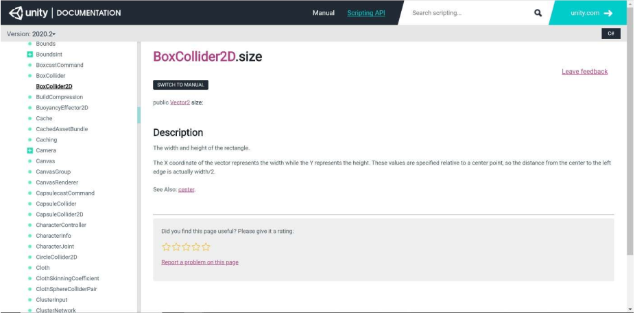
6.23 Spawning Into a Collision-Free Location
BoxCollider2D Size Documentation

Slide 17
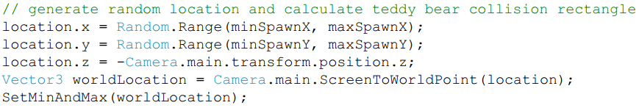
6.23 Spawning Into a Collision-Free Location
Final change is to the TeddyBearSpawner SpawnBear method. We replace the code we originally had to generate a random location and create the new teddy bear object with the following code.

Slide 18
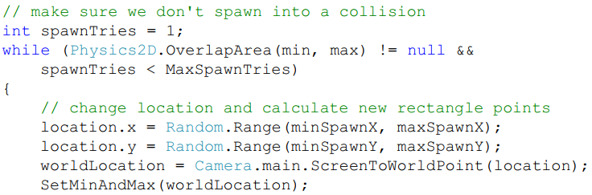

6.23 Spawning Into a Collision-Free Location

Slide 19
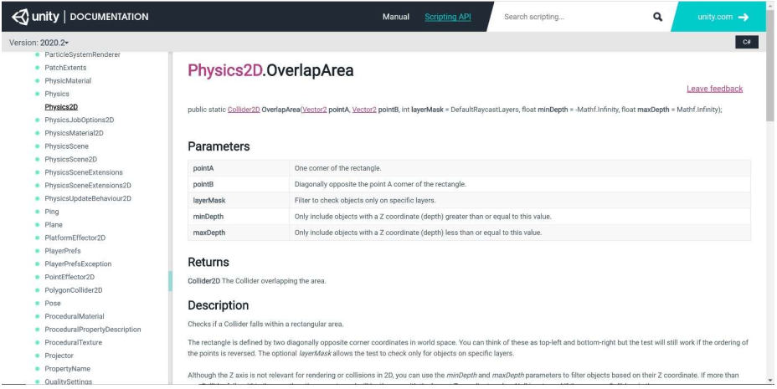
6.23 Spawning Into a Collision-Free Location
Physics2D OverlapArea Documentation

Slide 20
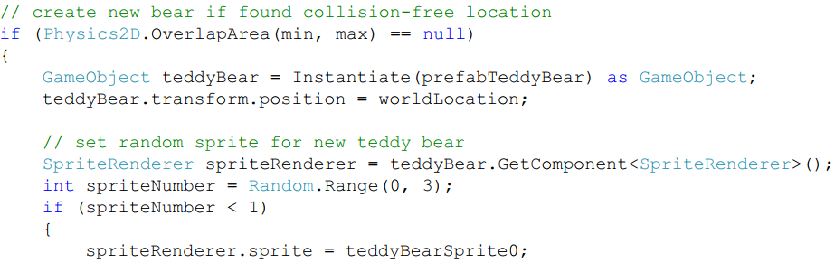
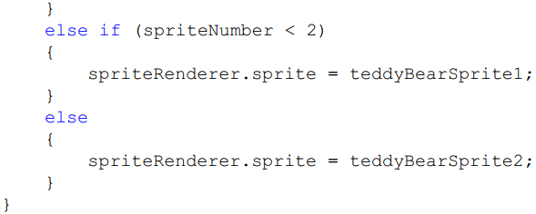
6.23 Spawning Into a Collision-Free Location
The code in the SpawnBear method

Slide 21
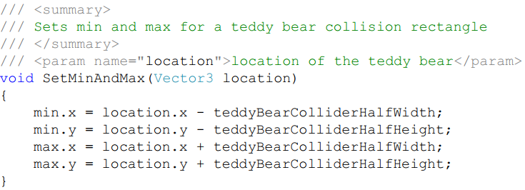
6.23 Spawning Into a Collision-Free Location
The SetMinAndMax method

Slide 22
6.24 Putting It All Together
The problem description
Develop a method that starts at a particular location in a list of strings, searching for the next occurrence of "inactive". The search needs to examine every string in the list, returning the index of the next occurrence of "inactive" or -1 if "inactive" doesn’t appear in the list.
Understand the Problem
To make sure we understand the problem, let’s think about all the possibilities for occurrences of "inactive" in the list (this will help us develop our test cases as well).
Design a Solution
develop a single method to solve this problem.
come up with an algorithm for the method before we implement the code.

Slide 23
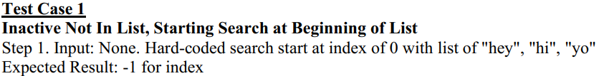
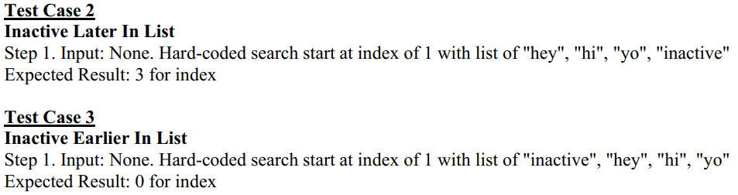
6.24 Putting It All Together
Write Test Cases

Slide 24
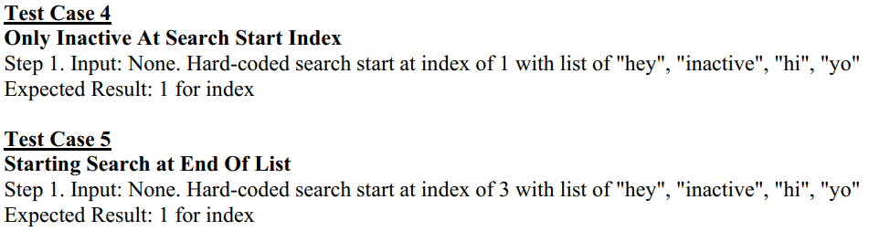
6.24 Putting It All Together
Write Test Cases

Slide 25
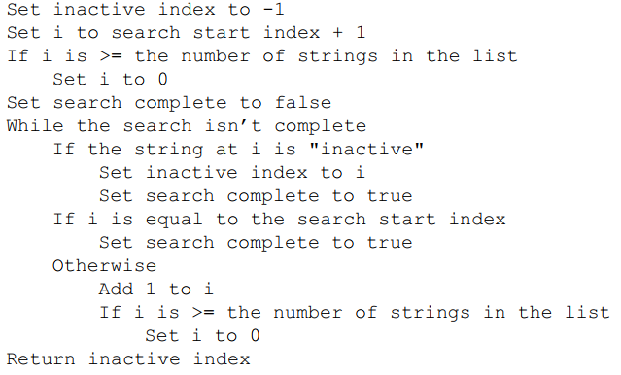
6.24 Putting It All Together
Write the Code
Algorithm: There are number of ways which can solve this problem

Slide 26
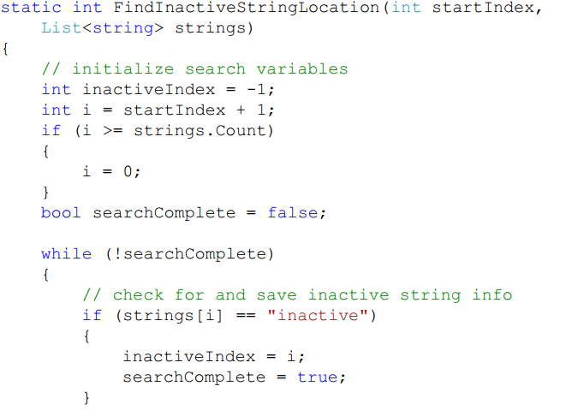
6.24 Putting It All Together
Write the Code

Slide 27
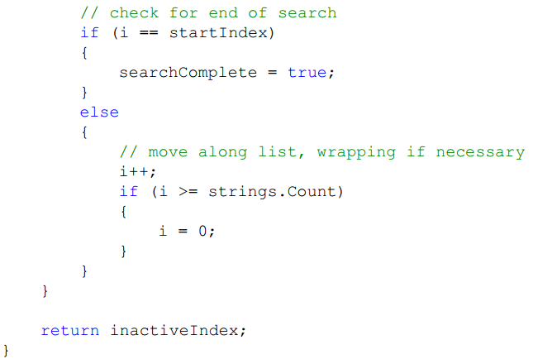
6.24 Putting It All Together
Write the Code

Slide 28
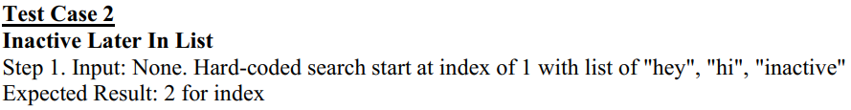
6.24 Putting It All Together
Test the Code
To get the loop body to execute once, we can provide a list where "inactive" is in the location immediately following the start location ➔ modify the list in Test Case 2 to cover this.

Slide 29
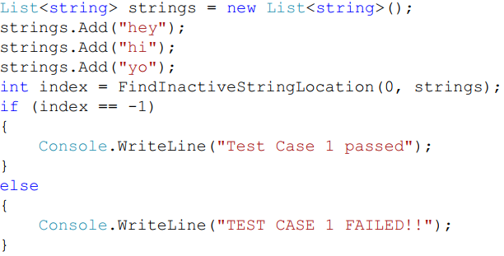
6.24 Putting It All Together
Test the Code
To test the code, we embedded the method we wrote into a console application and had the Main method in that application execute all the test cases for us. For example, code to execute Test Case 1:

Slide 30
6.25 Common Mistakes
Forgetting ITM in a Loop
make sure all the variables contained in the Boolean expression for the loop are initialized.
make sure that at least one of the variables in the Boolean expression is modified in the loop before get back to the test again
Using an If Statement Instead of a While Loop

Slide 31
Summary
Array
Collection Classes
For Loops
Foreach Loops
While Loops
Do-While Loops

